Slide 1
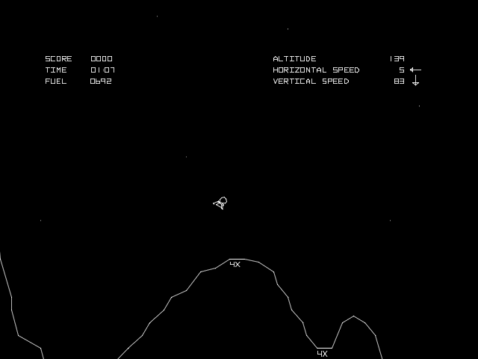
Lunar Lander Design – Mark’s Design #1:
HOMEWORK:
Modify the (provided) brain design and create two other brain designs for the following assumptions:
a) Landing doesn’t happen until the end therefore it can be sequential.
b) Experiment with advanced perception modules
Explain your assumptions and how they are reflected in your brain design.
Remember to post these brain designs and assumptions to the forum and engage in conversations with the other Autonomous AI Architects in practice. That is exactly what brain design architects do.
KNOWLEDGE
Flag1 Position (x,y)
Flag2 Position (x,y)
SENSES
Position (x,y)
Angle (alpha)
Velocity (vx, vy)
Angular Velocity (valpha)
Left Leg Contact (1,0)
Right Leg Contact (1,0)
PERCEPTIONS
CONCEPTS
Hovering
Stabilizing
Centering
Approaching
Landing
SKILLS
Hovering
Ascend(+/-)
Translate (+/-)
Rotate (+/-)
STRATEGIES
Hover()
Stabilize()
Center()
Approach()
Land()
EXPLANATION OF DESIGN #1:
By defining a NEW concept “Approaching” with an associated Strategy “Approach()” we can use Approach() to travel FASTER before beginning the “Land()” strategy, thereby REDUCING TIME TO LAND, which is one of the GOALS of this design…
Hover()
input
Stabilize()
output
Center()
LEGEND:
Input/Output
Selector
Strategy
Or Connector
DRL
Approach()
Land()

Slide 2
Lunar Lander Design – Mark’s Design #2:
HOMEWORK:
Modify the (provided) brain design and create two other brain designs for the following assumptions:
a) Landing doesn’t happen until the end therefore it can be sequential.
b) Experiment with advanced perception modules
Explain your assumptions and how they are reflected in your brain design.
Remember to post these brain designs and assumptions to the forum and engage in conversations with the other Autonomous AI Architects in practice. That is exactly what brain design architects do.
KNOWLEDGE
Flag1 Position (x,y)
Flag2 Position (x,y)
Minimum Safe Altitude (ymin)
Maximum Radar Range (m)
SENSES
Position (x,y)
Angle (alpha)
Velocity (vx, vy)
Angular Velocity (valpha)
Left Leg Contact (1,0)
Right Leg Contact (1,0)
Radar
PERCEPTIONS
Obstacle (x,y)
CONCEPTS
Hovering
Stabilizing
Centering
Approaching
Landing
SKILLS
Hovering
Ascend(+/-)
Translate (+/-)
Rotate (+/-)
STRATEGIES
Hover()
Stabilize()
Plot() & Follow()
Center()
Approach() & Land()
EXPLANATION OF DESIGN #2:
By defining a new Sense “Radar” with associated Perception “Obstacle” which stands between Position and FlagPosition, we can then create 2 new Strategies Plot() which plots a path to Maximum Radar Range and then we use another new Strategy “Follow()” to follow the obstacle (the surface of hill in front of the flags) at a Minimum Safe Altitude until there is no longer an Obstacle, after which we can then Center(), Approach() and Land() …
Hover()
input
Obstacle()
Stabilize()
Plot()
Follow()
output
LEGEND:
Input/Output
Selector
Strategy
Or Connector
DRL
Advanced Perception
Center()
Approach()
Land()

Slide 4
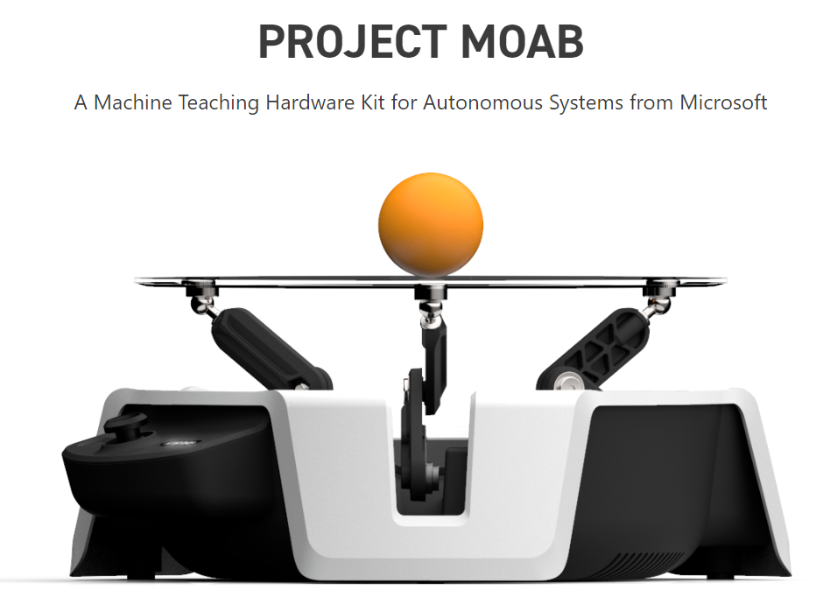
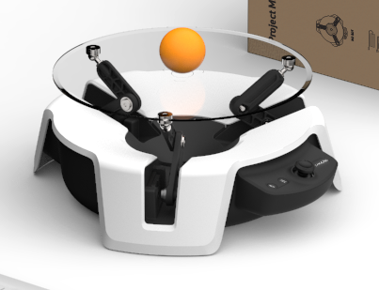
Moab Ball-Balancer Design – Mark’s Design #1:
HOMEWORK:
Modify the above brain design and create two other brain designs for the following assumptions:
a) Extract the advanced perception outside the input sensors.
b) Experiment with other skills.
Explain your assumptions and how they are reflected in your brain design.
Remember to post these brain designs and assumptions to the forum and engage in conversations with the other Autonomous AI Architects in practice.
KNOWLEDGE
Arm1 Range [R1]
Arm2 Range [R2]
Arm3 Range [R3]
SENSES
Ball Position (x,y)
Arm1 Position (r1)
Arm2 Position (r2)
Arm3 Position (r3)
PERCEPTIONS
Ball Position (r1, r2, r3)
Ball Velocity (v1, v2, v3)
CONCEPTS
Stabilizing
SKILLS
Stabilize()
STRATEGIES
Stabilize()
EXPLANATION of Design #1:
IF we DON’T use RECTANGULAR coordinates for BallPosition (x,y) and BallVelocity(vx,vy) and instead CONVERT them (this is an AdvancedPerception) to POLAR coordinates for BallPosition (r1, r2, r3) and BallVelocity(vr1, vr2, vr3), then “Stabilize()” simply becomes sending each Arm a single signal to “reverse” until it sees its own vri finally reach ZERO. This empowers each arm to work use the SAME senses (BallPosition x,y) converted to BallPosition(r1, r2, r3), but basically RESPOND to ONLY the coordinate that is MEANINGFUL to that arm, and IGNORE all the others ☺
BallPosition (r1, r2, r3)
BallVelocity (vr1, vr2, vr3)
Stabilize()
input
output
LEGEND:
Input/Output
Selector
Strategy
Or Connector
DRL
Advanced Perception

Slide 5
Moab Ball-Balancer Design – Mark’s Design #2:
HOMEWORK:
Modify the above brain design and create two other brain designs for the following assumptions:
a) Extract the advanced perception outside the input sensors.
b) Experiment with other skills.
Explain your assumptions and how they are reflected in your brain design.
Remember to post these brain designs and assumptions to the forum and engage in conversations with the other Autonomous AI Architects in practice.
KNOWLEDGE
SENSES
Ball Position (x,y)
Arm1 Position (r1)
Arm2 Position (r2)
Arm3 Position (r3)
PERCEPTIONS
Ball Position (r1, r2, r3)
Ball Velocity (v1, v2, v3)
CONCEPTS
Stabilizing
Centering
Translating
Arc-ing
SKILLS
Stabilize()
Center()
TranslateX()
TranslateY()
STRATEGIES
Stabilize()
Center()
TranslateXY()
TracePath()
EXPLANATION of Design #1:
By creating the ADVANCED PERCEPTIONS of POSITION and VELOCITY using POLAR COORDINATES, it is not only TRIVIAL to “stabilize” (read “render inert”) the ball, but we SHOULD be able to also REPOSITION it to ANYWHERE on the table top and even TRACE A PARTICULAR PATH on the table top :-O
These then are some ADDITIONAL skills/strategies as show in the table & diagram ☺
Stabilize()
BallPosition (r1, r2, r3)
BallVelocity (vr1, vr2, vr3)
Center()
input
output
TranslateXY()
LEGEND:
Input/Output
Selector
Strategy
Or Connector
DRL
Advanced Perception
TracePath()

Slide 7
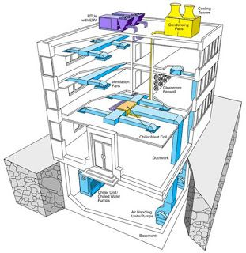
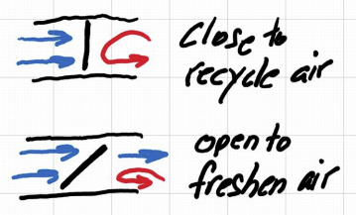
HVAC Design – Mark’s Design #1:
HOMEWORK:
Modify the provided brain design for the following assumption:
1. Add Advanced Perception.
Explain your assumptions and how they are reflected in your brain design.
KNOWLEDGE
Past Power Cost
Target Temperature
Target CO2 Level
SENSES
Damper Angle (deg)
Indoor Temperature (F)
Outdoor Temperature (F)
Indoor CO2 Level (%)
PERCEPTIONS
PowerCost(date, time) -> $/min
CONCEPTS
Regulating
SKILLS
Regulate()
STRATEGIES
Regulate()
EXPLANATION OF DESIGN #1:
From KNOWLEDGE of PastElectricityCosts we can create a predictive ML model to predict (this is an ADVANCED PERCEPTION) the PowerCost() on a given date at a given time…
From a (new) CO2 sensor we can detect the Current CO2 level, so it can be compared to the threshold…
SO with KNOWLEDGE of the COST at any given moment the Regulate() strategy can be trained to decide on a DAMPER ANGLE and a TIME which minimizes COST while maintaining TEMPERATURE and staying under the CO2 threshold ☺
!!! I DON’T THINK that “Recycle()” is a SEPARATE skill/strategy; it’s merely a special case of “Regulate()” wherein the damper is completely closed – typically for a short period of time, because the moment there’s NO exchange with FRESH air the CO2 levels start to go UP ! DELETING this “redundant” skill/strategy…
Recycle()
PowerCost(date, time)
input
output
LEGEND:
Input/Output
Selector
Strategy
Or Connector
DRL
Advanced Perception
Regulate()

Slide 9
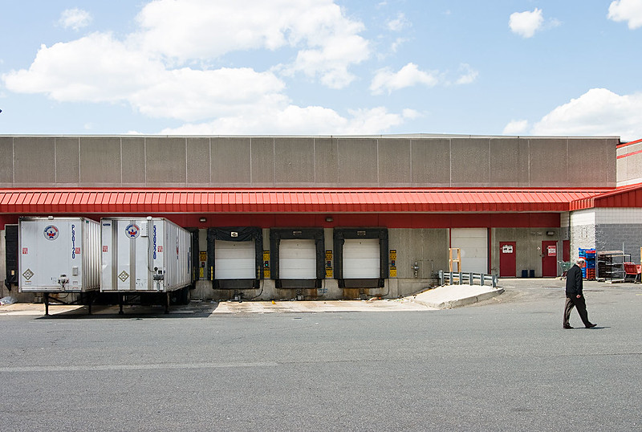
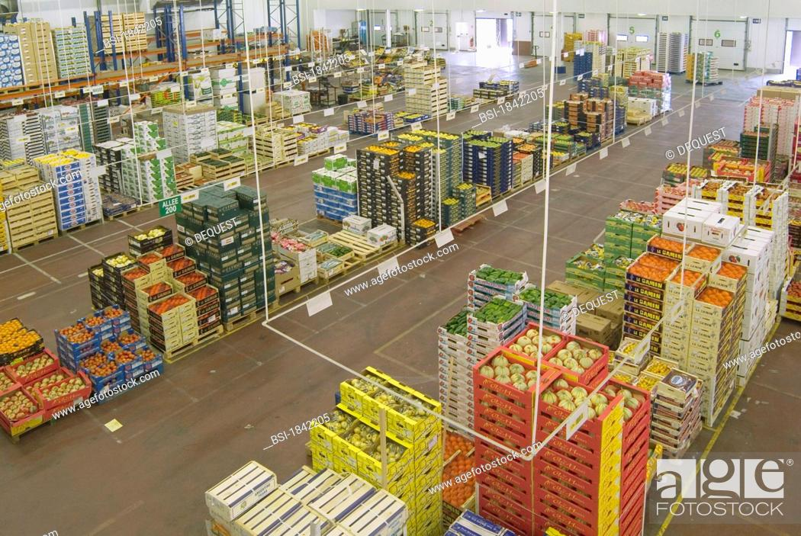
Warehouse Logistics Design – Mark’s Design #1:
HOMEWORK:
Modify the above brain design to add the following assumptions:
a) Advance perception.
b) Other strategies.
Explain your assumptions and how they are reflected in your brain design.
Remember to post these brain designs and assumptions to the forum and engage in conversations with the other Autonomous AI Architects in practice.
KNOWLEDGE
Warehouse Layout
Drivers working
SENSES
Locations(products)
Inventory (products)
Locations (drivers)
PERCEPTIONS
Locations(products)
Demand(products, date)
Locations(drivers)
CONCEPTS
Relocating
Distributing
Consolidating
SKILLS
Relocate()
Distribute()
Consolidate()
STRATEGIES
Relocate()
Distribute()
Consolidate()
EXPLANATION OF DESIGN #1:
Having only 2 primitive “Consolidate()” and “Distribute()” strategies is overly-SIMPLE; we can do BETTER than that!
INTRODUCE a new AdvancedPerception “Demand(product, date)”; this predicts if a given product will be in HIGH or LOW demand that day;
INTRODUCE a new AdvancedPerception “ProductLocations(product) so now you know where that product CURRENTLY is;
CREATE a new Strategy “Relocate(demand, product)” which produces a set of actual INSTRUCTIONS for each forklift driver so they move a pallet of product A from Location 1 to Location 2 (distributed or consolidate is TOO PRIMITIVE) to best prepare for the demand of that product for the given day!
EXTEND/ENHANCE with an AdvancedPerception ‘real-time location of each DRIVER (forklift)” so you can ROUTE OPTIMIZE!
RETAIN Distribute() and Consolidate() for use during “crisis” moments when unexpected things happen
and the entire warehouse needs to “scramble” and just use simpler instructions to get through the day…
Distribute()
Demand(product, date)
Locations(product)
Relocate()
input
output
LEGEND:
Input/Output
Selector
Strategy
Or Connector
DRL
Advanced Perception
Consolidate()

